Slide 1
COMET Use Case-Based Software Life Cycle & Use Case Modeling
COMP 3700: Modeling and Design
Tuesday, January 24, 2017
Gomaa, 2011; Pettit, 2014

Slide 2
In Class: Straw House Activity
Get into groups of 6
Roles
Facilitator
Timekeeper
Scribe
Runner
Client/Customer
Lead Builder
Procedure
Select Team Roles (5 minutes)
Talk with client/customer (5 minutes)
Build (15 minutes)
Assess client/customer satisfaction (5 minutes)
SEE FULL SET OF INSTRUCTIONS IN CANVAS AND ON IN-CLASS HANDOUT

Slide 3
Life-Cycle Model
Specifies the various phases/workflows of the software process including:
requirements,
analysis (specification),
design,
implementation, and
Post-delivery maintenance
Also specifies the order in which they are to be carried out.

Slide 4
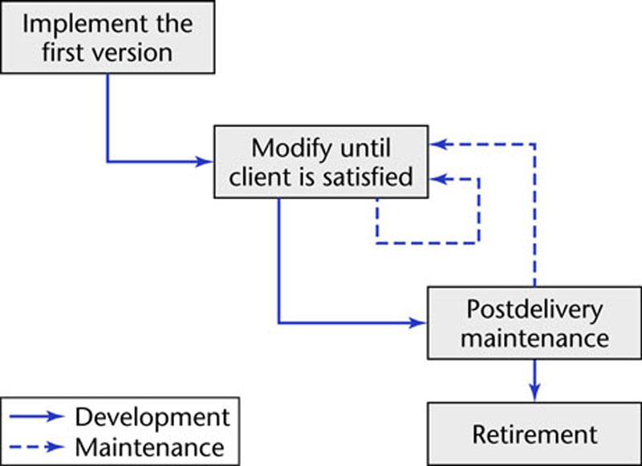
Code-and-Fix Life-Cycle Model
The easiest way to develop software
No design
No specifications
The most expensive approach for maintenance
The product is implemented without requirements or specifications, or any attempt at design.
The developers simply throw code together and rework it as many times as necessary to satisfy the client.
Used in small projects
Completely unsatisfactory for products of any reasonable size
Notes:
The easiest way to develop software
The most expensive way

Slide 5
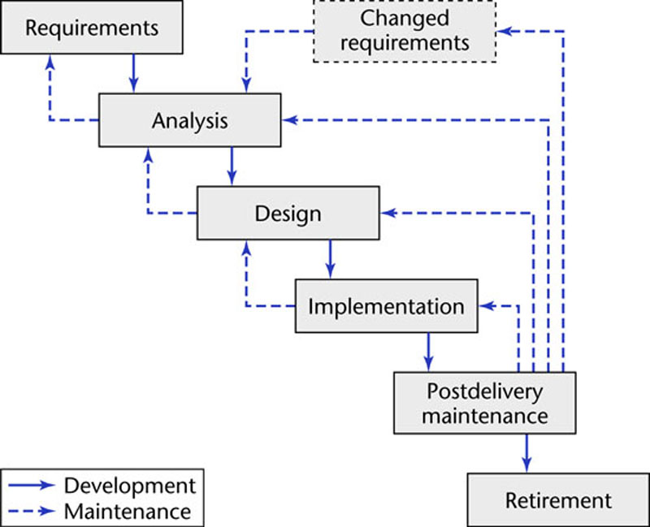
Waterfall Life-Cycle Model
Linear model with feedback loops
No phase is complete until
documentation for that phase has been completed
products of that phase have been approved by the software quality assurance (SQA) group.
If the products of an earlier phase have to be changed as a consequence of following a feedback loop, that earlier phase is deemed to be complete only when the documentation for the phase has been modified and the modifications have been checked by the SQA group.

Slide 6
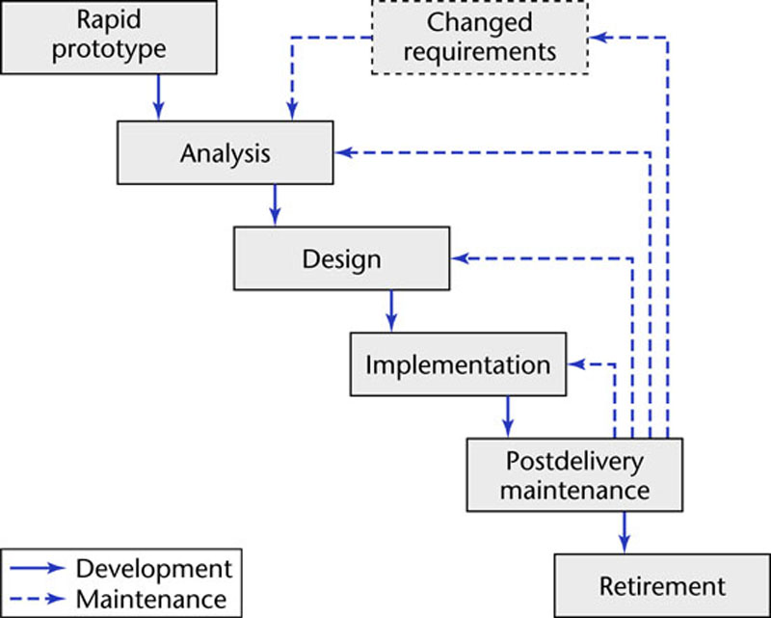
Rapid-Prototyping Life-Cycle Model
Linear model
A rapid prototype a model that is functional and represents a subset of the product
Build a rapid prototype and let the client and future users interact and experiment with the rapid prototype.

Slide 7
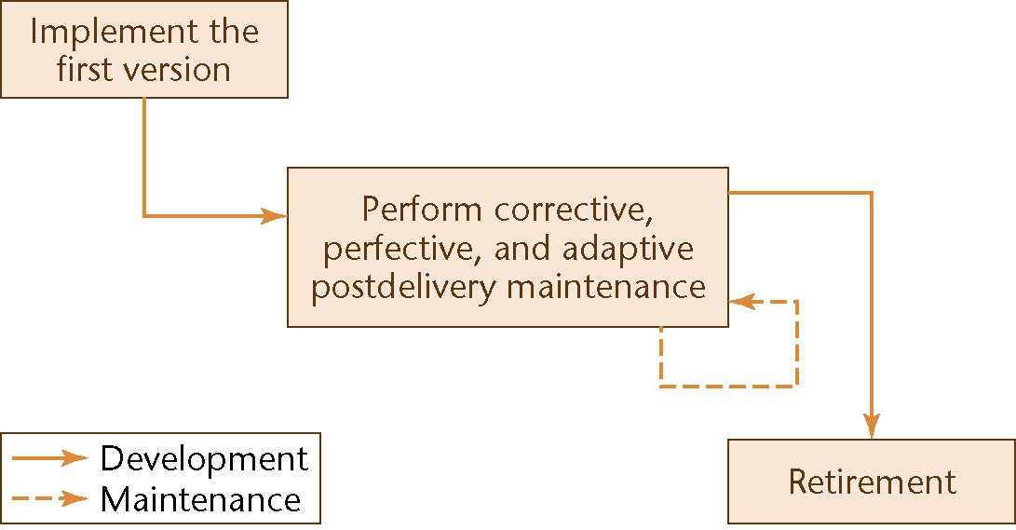
Open-Source Life-Cycle Model
Post-delivery maintenance life cycle model
The first informal phase
One individual builds an initial version and makes it available via the Internet
If there is sufficient interest in the project, the initial version is widely downloaded; users become co-developers; and the product is extended
Individuals generally work voluntarily on an open-source project in their spare time

Slide 8
Iterative and Incremental Life-Cycle Model: Iteration
In the real life, we cannot speak about “the analysis phase”
Instead, the operations of the analysis phase are spread out over the life cycle as a consequence of both the moving target problem and the need to correct the inevitable mistakes
Moving target problem: the requirements change while the software product is being developed. This change is inevitable
The basic software development process is iterative
Each successive version is intended to be closer to its target than its predecessor

Slide 9
Agile Processes: Extreme Programming (Cont.)
Based on the features (stories/scenarios) the client wants:
The development team estimates the duration and cost of each feature
The client selects the features for next build using cost-benefit analysis
The proposed build is broken down into smaller pieces termed tasks
The programmer draws up test cases for a task → Test-driven development (TDD)
Pair Programming: The programmer works together with a partner on one screen to implement the task and ensure that all the test cases work correctly.
Continuous integration of tasks since a number of pairs implement tasks in parallel
The TDD test cases used for the task are retained and utilized in all further integration testing.

Slide 10
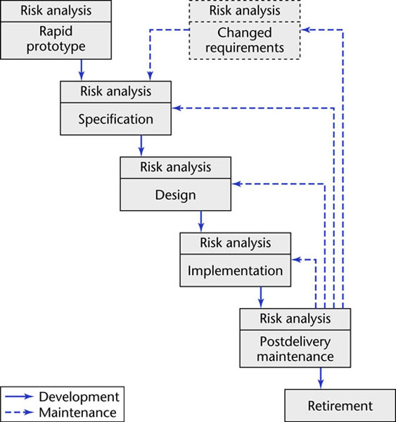
Spiral Life-Cycle Model
Minimize risk via the use of prototypes and other means.
Two types of risk
Analyzable Risk
Time and cost
Un-analyzable Risk
Personnel turnover
Difference between small-scale and large-scale software
Evaluate the delivery promises of a hardware supplier
Simplified form
Rapid prototyping model pus risk analysis preceding each phase
If all risks cannot be mitigated, the project is immediately terminated

Slide 11
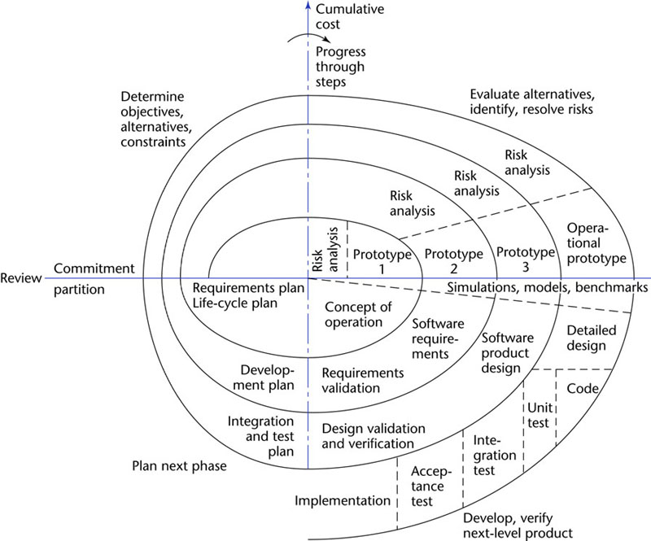
Full Spiral Life-Cycle Model
Full form
Precede each phase by
Alternatives
Risk analysis
Determining
Objective of the phase
Alternatives for achieving the objectives
Constraints imposed on those alternatives
Follow each phase by
Evaluation
Planning of the next phase
Radial dimension – cumulative costs to date
Angular dimension: progress through the spiral

Slide 12
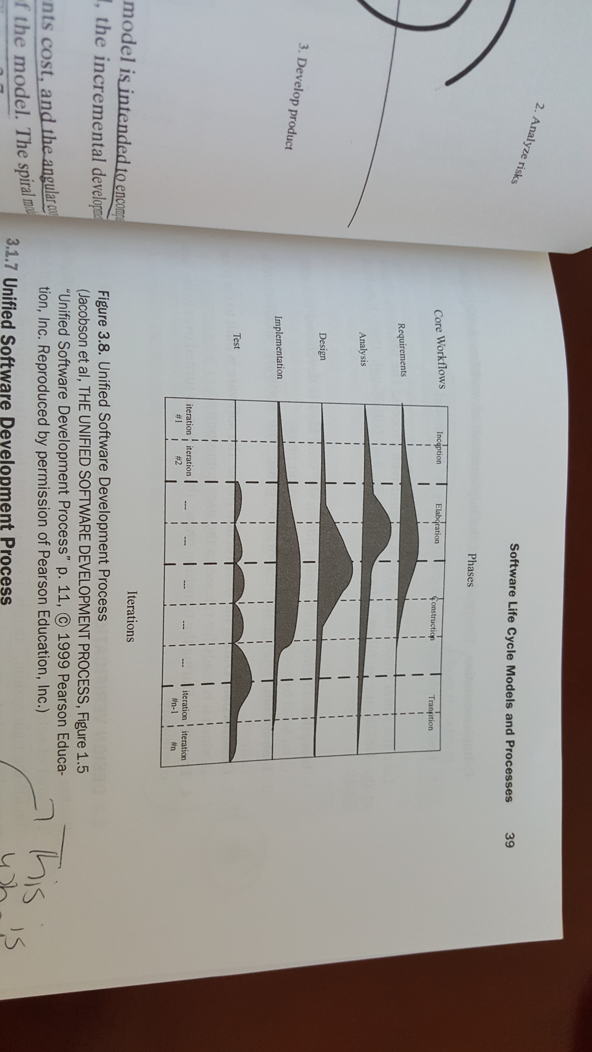
Unified Software Development Process
Use case-driven software process that uses the UML notation
AKA Rational Unified Process (RUP)
Risk-driven approach
Consists of 5 core workflows and four phases
Workflow – sequence of activities that produces a result of observable value
Phase – the time between two major milestones during which
A well defined set of objectives is met
Artifacts are completed
Decisions about whether to move on to the next phase are made
Iterative
Each cycle goes through all four phases and addresses the development of a core workflow

Slide 13
Unified Software Development Process
USDP/RUP life cycle workflows
Requirements
Product: Use case model
Analysis
Product: Analysis model
Design
Products: Design model & Deployment model
Implementation
Product: Implementation model
Test
Product: Test model
USDP/RUP life cycle phases
Inception – Seed idea is developed to a sufficient level to justify entering the elaboration phase
Elaboration – Software architecture is defined
Construction – Software is built to the point at which is is ready for release to users
Transition – Software is turned over to user community

Slide 14
COMET Use Case-Based Software Life Cycle
COMET use case-based software life cycle can be used with
Spiral life cycle model
Unified Software Development Process (USDP/RUP) life cycle model
Use case driven
Highly iterative
We’ll use this one

Slide 15
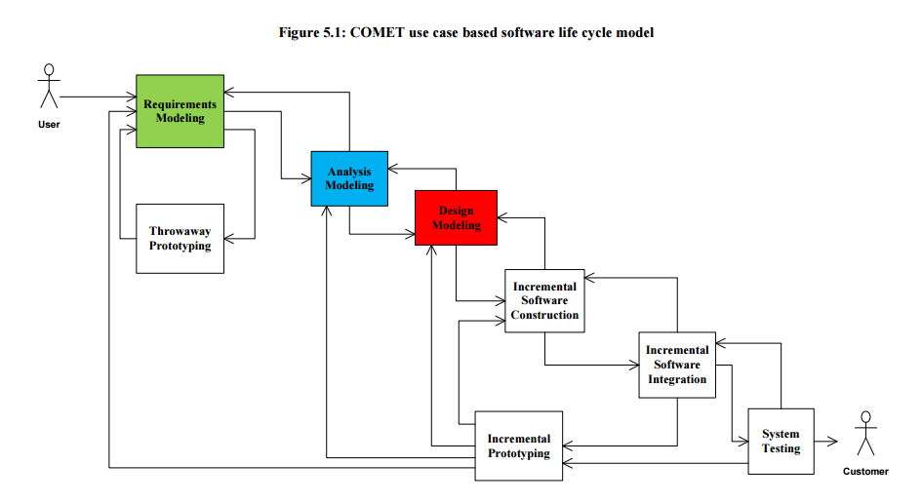
COMET Use Case Based Software Life Cycle Model

Slide 16
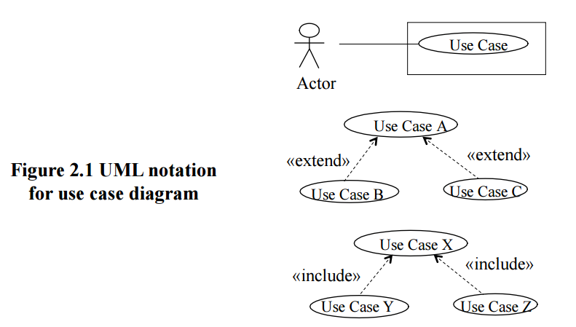
Requirements Modeling
Use Case Modeling
Define software functional requirements in terms of use cases and actors
Narrative description of each use case is developed
User inputs and active participation are essential to this effort

Slide 17
Watch the video on use cases
https://www.youtube.com/watch?v=nN7lTDWKP6g&t=28s

Slide 18
Quick Check-In
Stick Figure?
Oval?
Lines (arcs):
<< >>?
box?
Alter Student Grade
<<includes>>
Record Grades for a Section
Teacher

Slide 19
Use Cases are one way to capture requirements
A visual way to capture functional requirements
Each bubble is a discrete
user goal
Actors can be people, or
external systems
Each bubble is mapped to a
textual description

Slide 20
Use Case Description
Includes basic and alternate/exception flows
Each alternate flow must start at a step in the basic flow, and may return to a step in the basic flow
Exception flows are analogous to exceptions in code
Includes preconditions
Do not use language that hints at implementation details or system interactions
Avoid click, press, type, button, etc.
Unnecessarily limits creativity

Slide 21
Use Case Diagrams
Made up of three components
Actors (people or external systems)
Use Cases (with textual descriptions)
Relationships
Record class grades
Review Transcripts
Teacher
Authorized
Staff Worker
Student

Slide 22
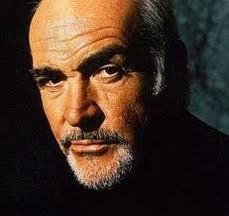
How to construct Use Cases: First, identify actors
Who or what will provide input to the system?
Who or what will need output from the system?
Turn to your neighbor: identify three actors for an ATM

Slide 23
Answer: identify three actors for an ATM
Customer
Database (for account information, etc) – external system
Maintenance person

Slide 24
Relationships between actors
One can be a specialization of another
Graduate student is a specialization of Student
Actors are classes, not individual people
Musicians NOT Jay-Z or Beyonce
Student
Graduate Student

Slide 25
How to construct use cases: Next, identify user goals
User Goals are statements that represent what the users need to accomplish, independent of specific software features
“Buy a book”
“Return a book”
“View order history”
“Record a log for a
transaction”
Turn to your neighbor: identify
five uses cases for
an ATM
http://destineemccaskill.com/goals/

Slide 26
Answer: identify five use cases for an ATM
Authenticate user
Withdraw funds
Deposit funds
Check balance
Transfer funds
Load bills
etc
Each would be a
bubble in diagram
http://destineemccaskill.com/goals/

Slide 27
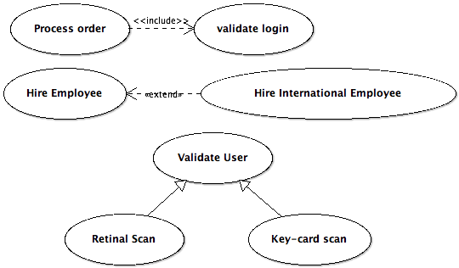
How to construct use cases: Finally, add relationships
Three types of relationships for use cases:
Includes
Extends
Generalization

Slide 28
Includes relationship
One use case can invoke the behavior of another
arrow goes toward included use case
Not always, but often a precursor
I.e. the “Buy a book” use case includes the “Authenticate customer”
Always reflect functionality that is common to more than one use case
See Section 6.8.1 in Gomaa for example of includes relationship
Alter Student Grade
<<includes>>
Record Grades for a Section
Teacher

Slide 29
Extends Relationship
Similar to the includes, but used for handling an abnormal situation (exception checking)
arrow goes toward extended use case
Asks questions
Akin to if->then construct
See 6.9 in Gomaa for an example of the extends relationship
Alter Student Grade
<<extends>>
Alter student grade for a class taken more than a year ago
Authorized
Staff Worker

Slide 30
Generalization Relationship
Replaces generic functionality with an concrete implementation
arrow goes toward extended use case
Authenticate user
Authenticate by card swipe
User
Authenticate by iris scan

Slide 31
Why Use Cases?
Visual representation easy to understand
Relationships are opportunities for reuse
Use case descriptions can be basis for testing
Can be the basis for planning and scheduling

Slide 32
Participation Activity 1: In-Class Use Case Modeling Exercise
1. Draw a use case diagram for the following system:
The website shall allow users to view all of their bills with Shelby County (such as trash bills, water bills property taxes due, and parking tickets). A bill is expected to be paid on time, but there should be a mechanism to pay a late bill as well. To pay a bill, the user can choose the method (card, online check, or bank draft), the payment date, and the amount of the bill to pay. The user can view their current and past bills. Each evening, the system will interact with an external database that is able to process the daily payment transactions. This database interacts with the credit card companies and banks directly to process the payments.
Before viewing or paying any bills, the user must authenticate with the system by providing their username and password. If they don’t have these credentials, there will be an option on the homepage to create an account. Otherwise, once the user successfully logs in, they are able to view all of their bills and select to pay one or more bills.
2. If generalization relation(s) exist in your use case diagram (hint: at least one should), write a use case description for at least one of those generalization relations
Upload your use case diagram and use case description into Canvas

Slide 33
Preparation Activity 2
Write up responses to the following questions (Due by 11:59pm tonight (1/24/17)):
What is a single use case?
What is a use case description?
What is a use case diagram?
What is an actor?
What is a relation?
includes relation?
extends relation?
generalization relation?
which way does the arrow go?
Upload Participation Activity 1 deliverables (Due by Tuesday, January 31, 2017)

